Slide 1
Apache NiFi / Apache Beam / Apache Airflow

Slide 2
Apache NiFi
Apache NiFi automates the movement of data between disparate data sources and systems, making data ingestion fast, easy and secure.
NiFi can not only ingest the data from several sources but deliver the data to as many consumers (APIs, Kafka, NoSQL, FTP and many more).
Unlike Sqoop & Flume, NiFi provides web-based UI that allows developing flow by dragging and dropping boxes on a canvas.
Drawback is, its not good for computations and can’t replace ETL

Slide 3

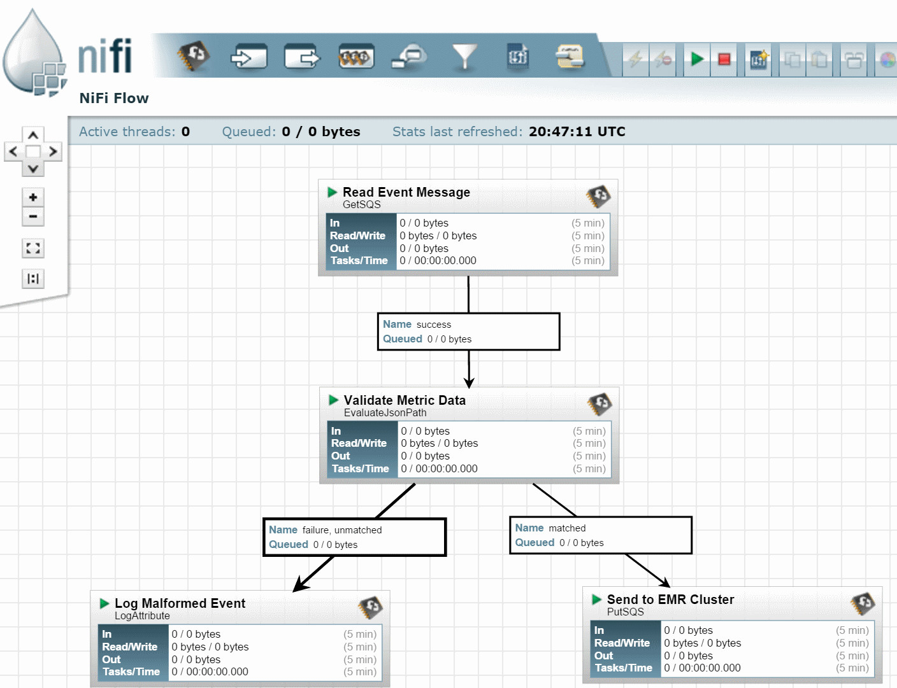
NiFi Flow

Slide 4
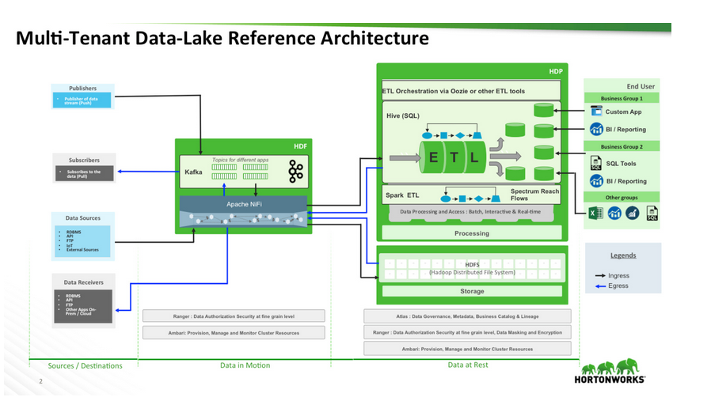
Data Lake Architecture Example with NiFi

Slide 5
Apache Beam
Open-source unified programming model
Used to define and execute data processing pipelines, which includes ETL and both batch and stream processing
SDK’s are available in Java ,Python & Go
These SDK’s are used to build a program that can define a pipeline
The pipeline would be executed by any of the Beam distributed processing back-ends which involve some of the beam runners like Apache Spark, Apache Flink Apache Apex etc.

Slide 6
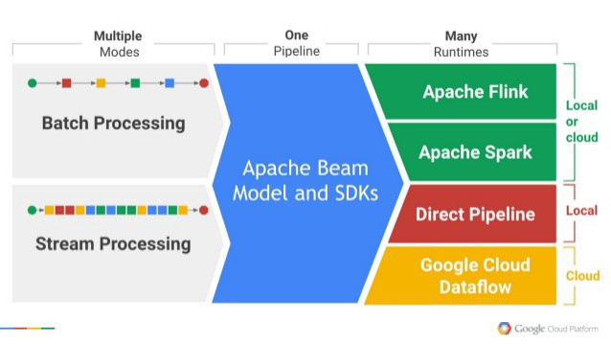
Apache Beam Architecture

Slide 7
Apache Airflow

